Slide 1
Qubit Rotation Simulator
By
Qbit Musketeers
Praveen Venkatachalam
Furqan Ali Khan
Vijay Anand Pandian

Slide 2
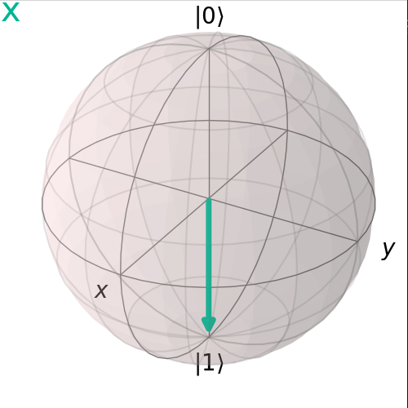
Qubit
A Qubit or quantum bit is a basic unit of quantum information—the quantum version of the classic binary bit physically realized with a two-state device.
It has two levels which are spin up and spin down.
Bloch sphere is a representation of a qubit.

Slide 3
Quantum Circuits
A quantum circuit is a type of computational procedure that combines simultaneous real-time classical computation with coherent quantum operations on quantum data like qubits.
It consists of a series of ordered quantum gates, measurements, and resets that can all conditionally use information from the real-time classical computation.

Slide 4
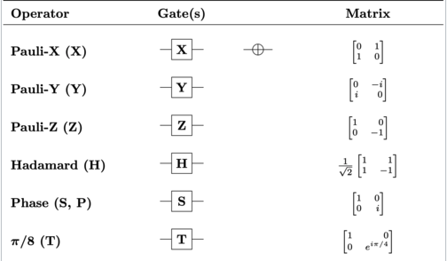
Quantum Gates
A basic quantum circuit using a few qubits is known as a quantum logic gate (or just a quantum gate).
Similar to how classical logic gates are the building blocks of traditional digital circuits, they are the building blocks of quantum circuits.
Quantum logic gates, in contrast to many classical logic gates, are reversible.

Slide 5
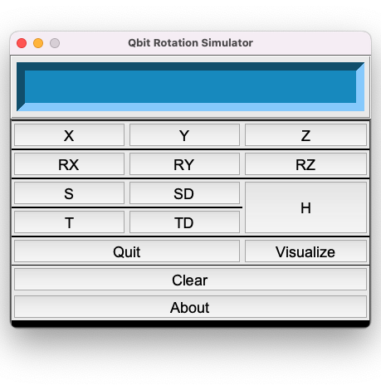
Qubit Rotation Simulator
This app is use to represent the rotation of Qubit in a Bloch sphere when is passed through different quantum gates.
This can be very useful for learning the basics of the qubit and its rotation operation(or Dirac change) in real-time.
This is achieved through python Qiskit and Tkinter.
Also, it helps visualise change in qbits when it is passed through a combination of quantum gates.

Slide 6
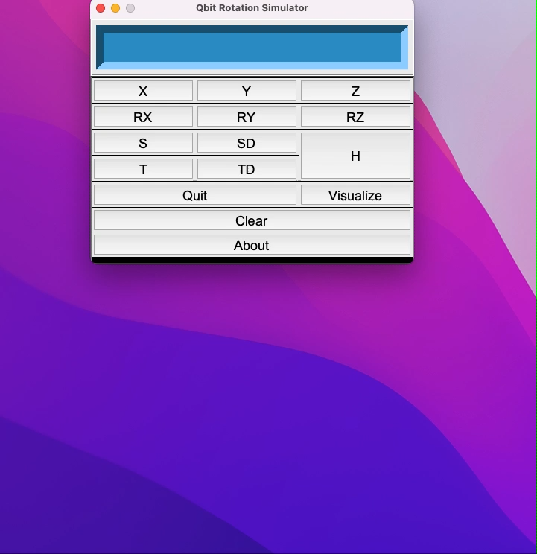
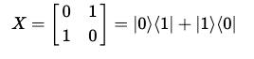
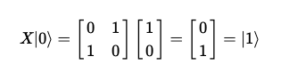
X-Gate
The X-gate is represented by the Pauli-X matrix:
To see the effect a gate has on a qubit, we simply multiply the qubit’s statevector by the gate. We can see that the X-gate switches the amplitudes of the states |0⟩ and |1⟩:

Slide 7
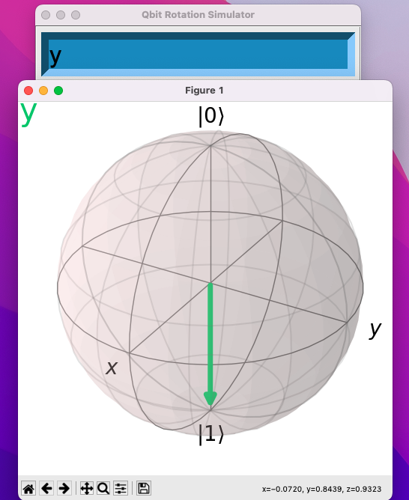
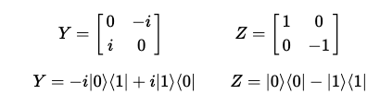
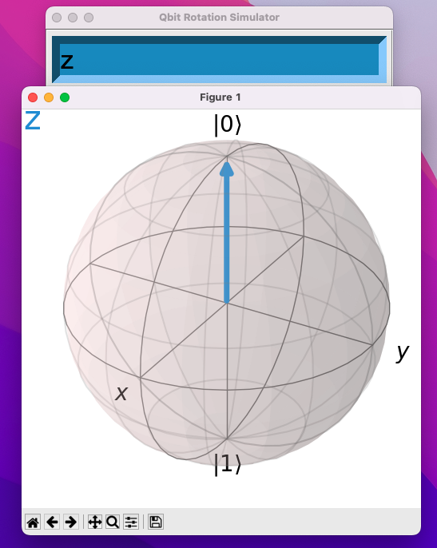
Y & Z-Gates
The Y & Z Pauli matrices also act as the Y & Z-gates in our quantum circuits:
they also respectively perform rotations by π around the y and z-axis of the Bloch sphere.

Slide 8
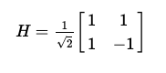
H-Gate
The Hadamard gate (H-gate) is a fundamental quantum gate. It allows us to move away from the poles of the Bloch sphere and create a superposition of |0⟩ and |1⟩. It has the matrix
We can see that this performs the transformations below:
H|0⟩ = |+⟩
H|1⟩ = |+⟩

Slide 9
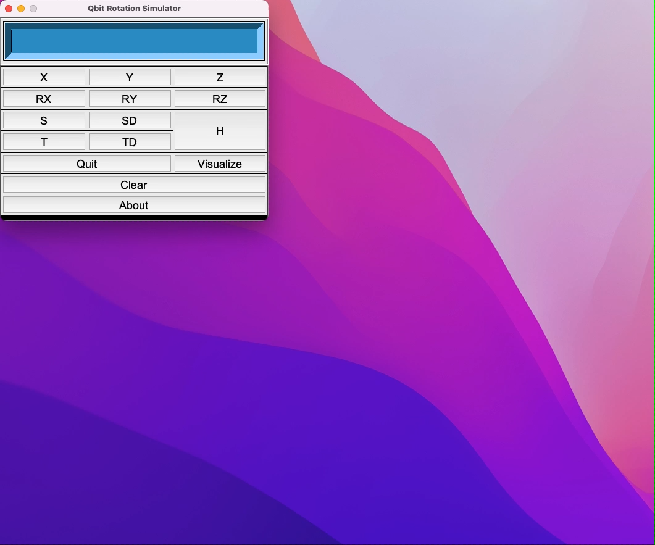
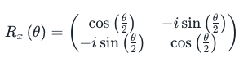
Rx-Gate
The Rx gate is one of the Rotation operators.
The Rx gate is a single-qubit rotation through angle θ (radians) around the x-axis.
Similiarly Ry and Rz gate is a single-qubit rotation through angle θ (radians) around the y-axis and z-axis respectively.

Slide 10
Thank You!

